Slide 1
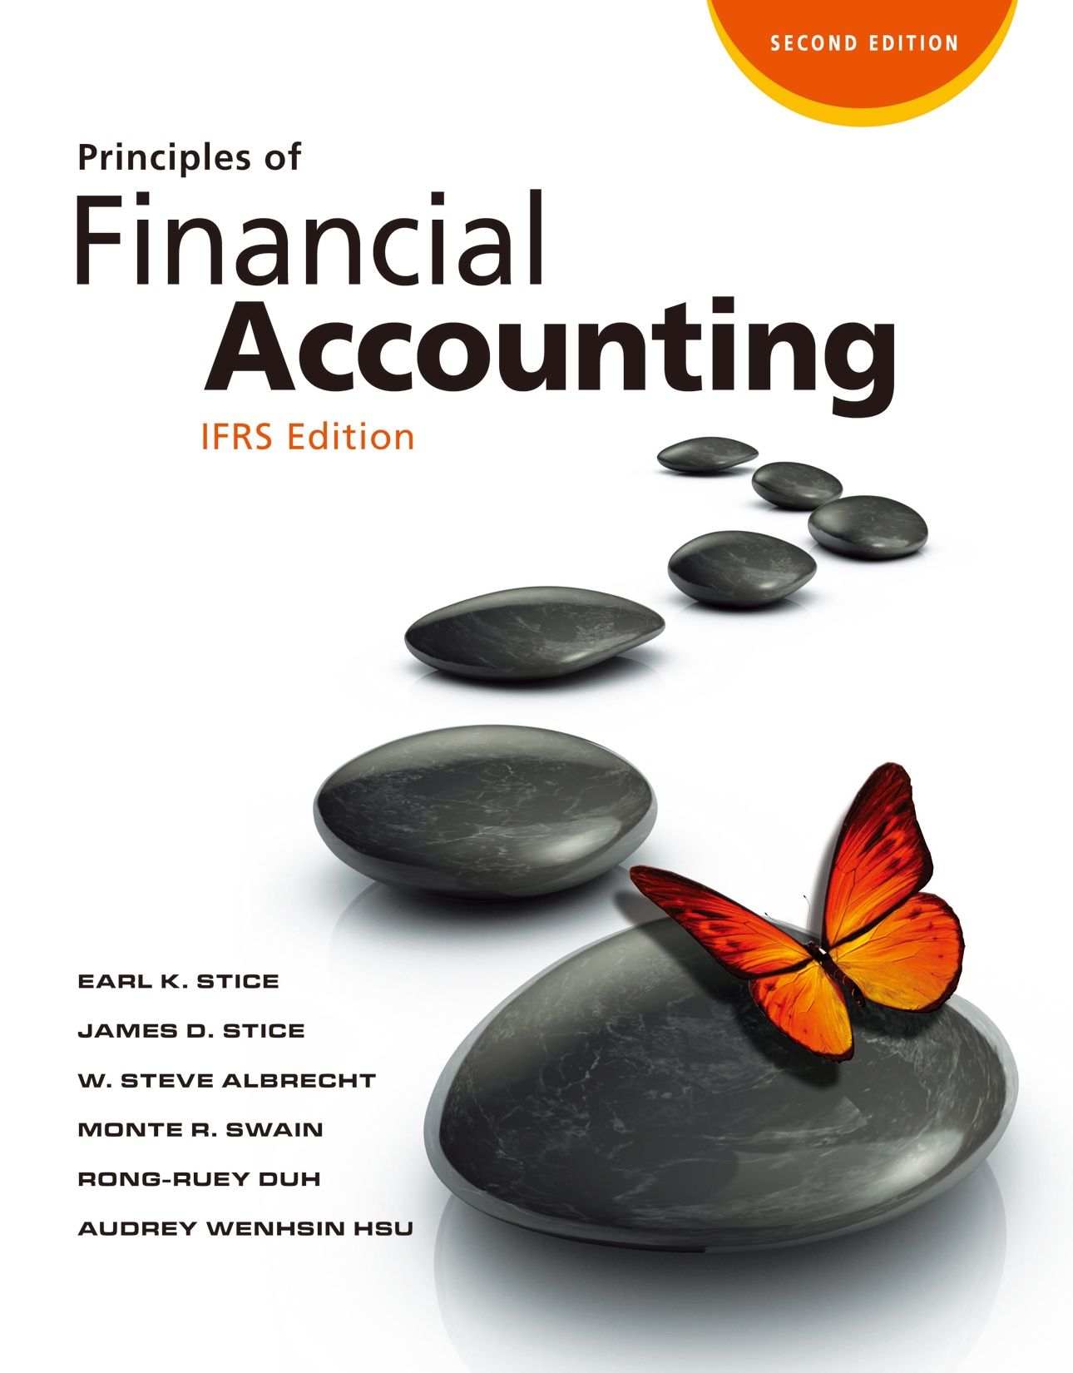

Slide 2
Statement of Cash Flows

Slide 3
Statement of Cash Flows

Slide 4
The Purpose of a Statement of Cash Flows
What’s the Purpose of a Statement of Cash Flows?
LO1
Provide information about the cash receipts and payments of an entity during a period.
Provide important information that complements the statement of comprehensive income and balance sheet.
Provide important information from a cash-basis perspective

Slide 5
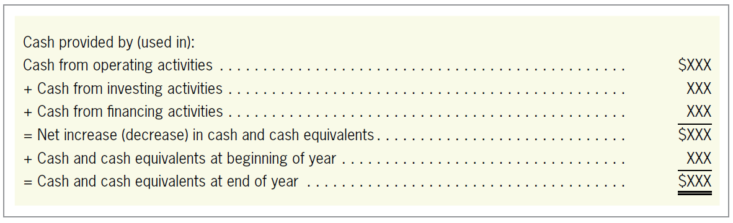
General Format for a Statement of Cash Flows
What Information Is Reported in the Statement of Cash Flows?
LO2
General Format for a Statement of Cash Flows
Exhibit 13.2

Slide 6
General Format for a Statement of Cash Flows
LO2
Cash Equivalents
Combined with cash.
Short-term, highly liquid investments that can easily be converted into cash.
Generally only investments with maturities of three months or less.

Slide 7
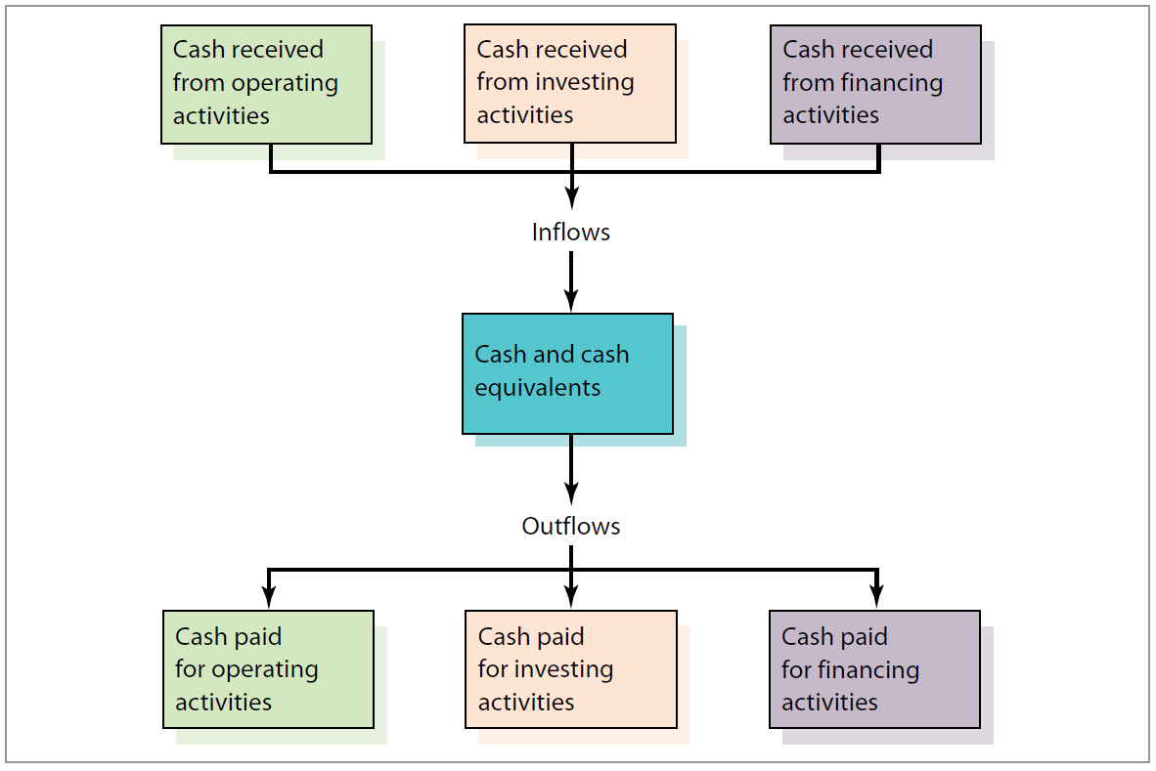
Major Classifications of Cash Flows
LO2
The Flow of Cash
Exhibit 13.3

Slide 8
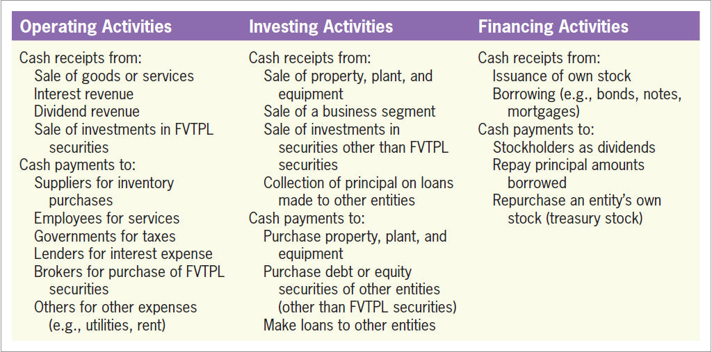
Major Classifications of Cash Flows
LO2
Exhibit 13.4

Slide 9
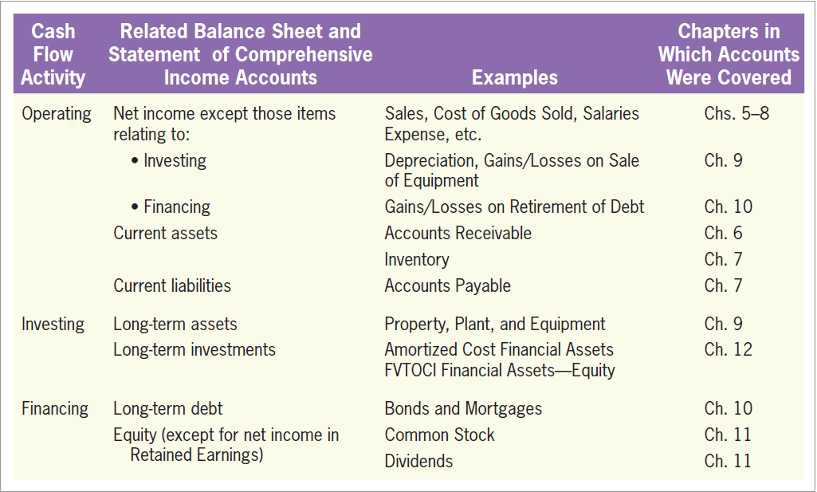
Major Classifications of Cash Flows
LO2
How Balance Sheet and Statement of Comprehensive Income Accounts Relate to the Statement of Cash Flows
Exhibit 13.5

Slide 10
Other Cash Flow Items
LO2
Non-cash Investing and Financing Activities
Some investing and financing activities do not affect cash. (i.e. equipment purchased with a note payable)
Not reported on the statement of cash flows.
Should be excluded from a statement of cash flows, and should be disclosed elsewhere in the financial statements.

Slide 11
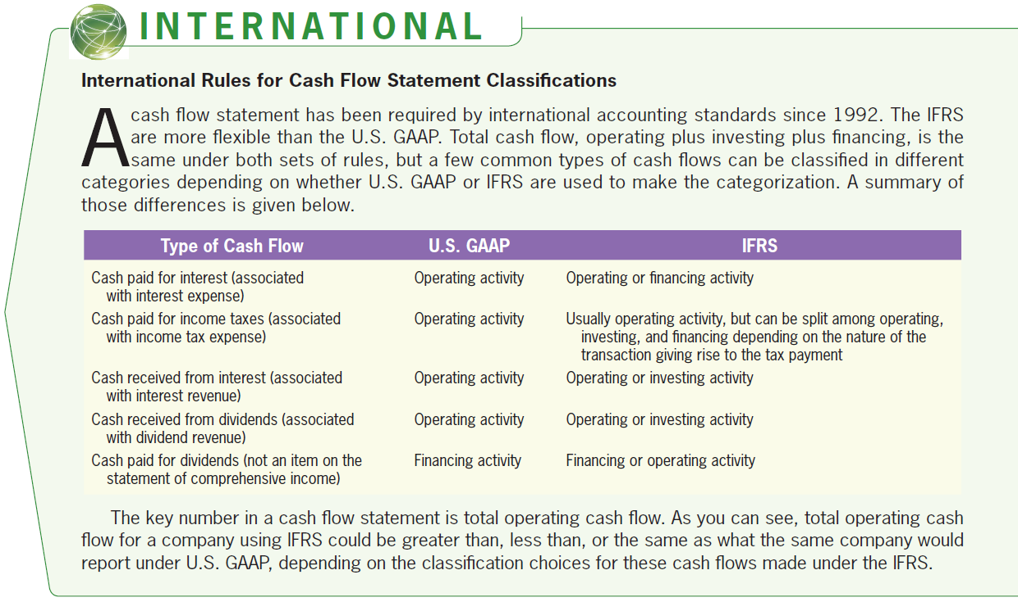
Classifications of Cash Flows
LO2

Slide 12
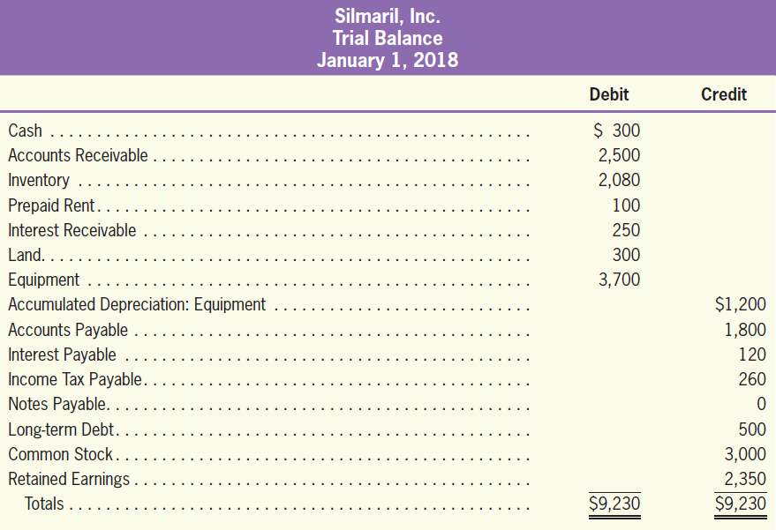
Acquire Cash Flow Information through the Cash Account
Preparing a Statement of Cash Flows—A Simple Example
LO3

Slide 13
Acquire Cash Flow Information through the Cash Account
LO3
The following transactions were conducted by Silmaril, Inc., during 2018:
1 | Made sales on account, $10,000.
2 | Collected payments on account, $10,500.
3 | Purchased inventory on account, $7,820.
4 | Recorded cost of goods sold, $7,900.
5 | Paid accounts payable, $7,900.
6 | Purchased land for $1,700 with $1,650 paid by cash and the remains paid by notes.
7 | Recorded depreciation expense for equipment, $500.

Slide 14
Acquire Cash Flow Information through the Cash Account
LO3
The following transactions were conducted by Silmaril, Inc., during 2018:
8 | Sold equipment for cash, $600 (original cost, $1,200; accumulated depreciation, $800).
9 | Paid long-term debt, $200.
10 | Borrowed new long-term debt, $250.
11 | Issued stock at par value, $500.
12 | Paid cash dividends, $510.
13 | Recorded interest expense (accrued), $110.
14 | Paid interest during the period, $130.

Slide 15
Acquire Cash Flow Information through the Cash Account
LO3
The following transactions were conducted by Silmaril, Inc., during 2018:
15 | Recorded interest revenue (accrued), $120.
16 | Received interest during the period, $200.
17 | Pre-paid rent expense in early January, $30.
18 | Recorded rent expense for accrued prepayments, $110.
19 | Recorded and paid wage expense for the year, $190.
20 | Recorded income tax expense for the period, $250.
21 | Paid income taxes during the period, $310.

Slide 16
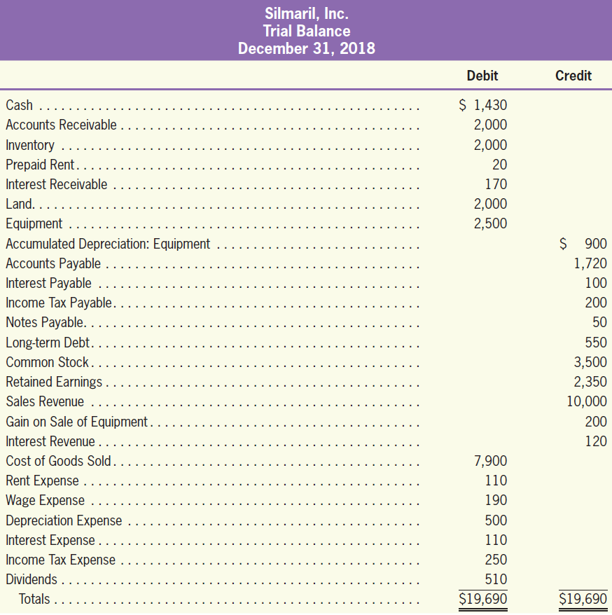
Acquire Cash Flow Information through the Cash Account
LO3
When the journal entries are posted, the following trial balance results:

Slide 17
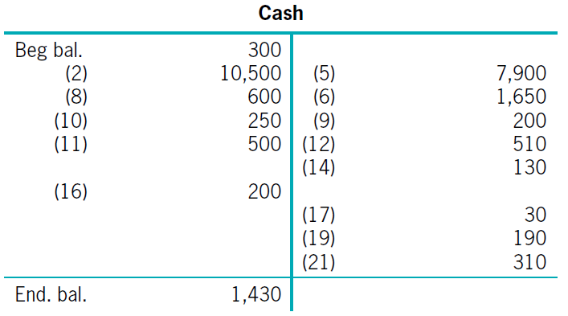
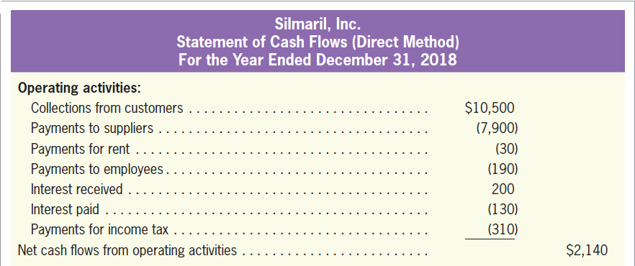
Acquire Cash Flow Information through the Cash Account
LO3

Slide 18
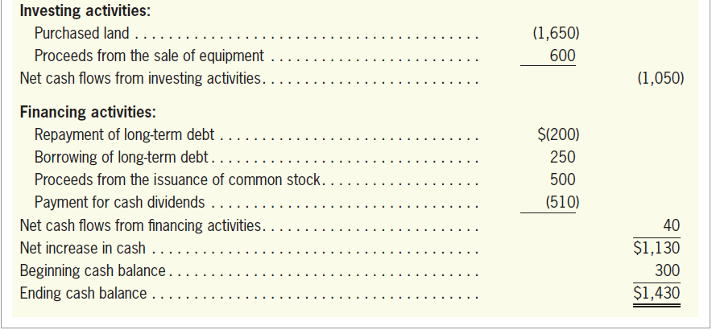
Acquire Cash Flow Information through the Cash Account
LO3

Slide 19
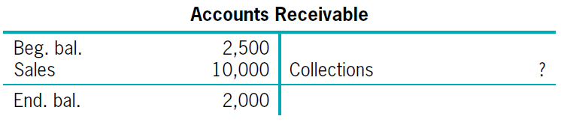
Acquire Cash Flow Information through Non-cash Accounts
LO3
When detailed cash flow information is not accessible, analyze the balance sheet and the statement of comprehensive income.
Collection = $2,500 + $10,000 – $2,000 = $10,500

Slide 20
Quiz Yourself
LO3
Given the following transactions, prepare a statement of cash flows:
Borrowed $10,000 from a bank.
Cash inflow of $10,000 = financing activity
Purchased inventory paying $3,800.
Cash outflow of $3,800 = operating activity
Sold inventory costing $3,200 for $7,100 in cash.
Cash inflow of $7,100 = operating activity

Slide 21
Quiz Yourself
LO3
Paid salaries and wages of $1,700.
Cash outflow of $1,700 = operating activity
Purchased equipment paying $5,700.
Cash outflow of $5,700 = investing activity
Paid other operating expenses of $1,100.
Cash outflow of $1,100 = operating activity

Slide 22
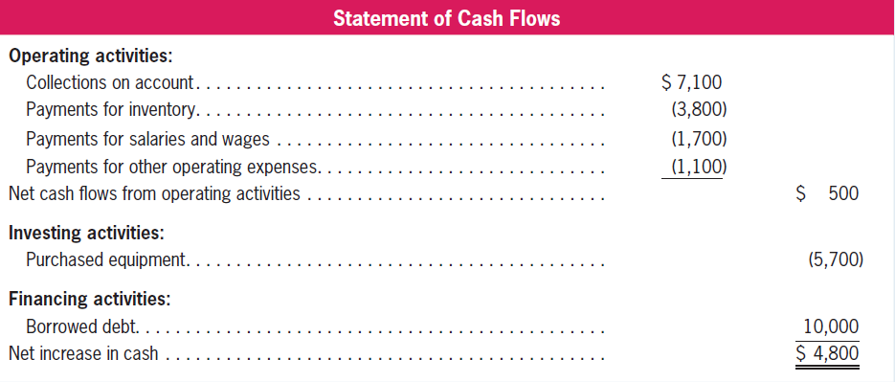
Quiz Yourself
LO3
Solution

Slide 23
Approaches to preparing cash flows from operating activities
Cash Flows from Operating Activities: Indirect Method
LO4
Direct Method
Show the major classes of cash receipts and payments for a period of time.
A cash-basis statement of comprehensive income.
Indirect Method
Convert accrual-basis net income to a cash basis.
Begins with net income (or income before income tax).

Slide 24
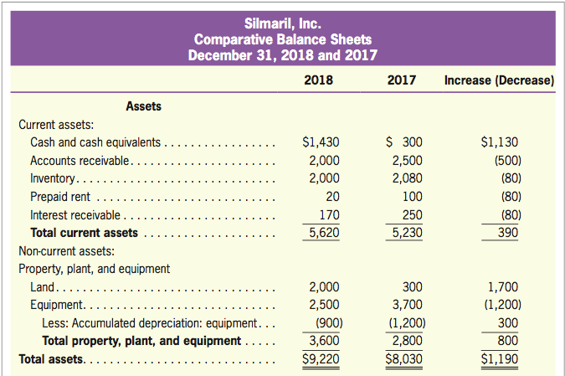
Approaches to preparing cash flows from operating activities
LO4
Exhibit 13.7

Slide 25
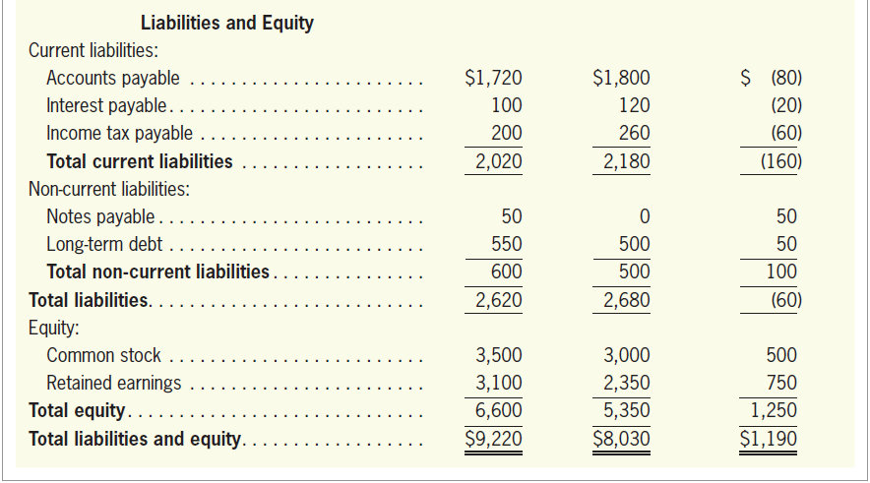
Approaches to preparing cash flows from operating activities
LO4
Exhibit 13.7

Slide 26
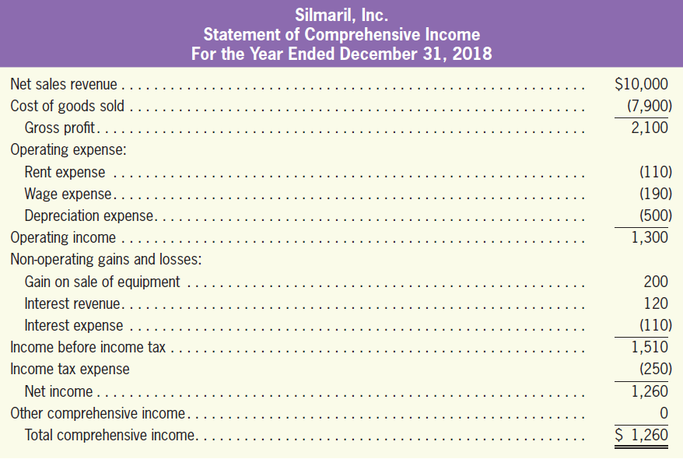
Approaches to preparing cash flows from operating activities
LO4
Exhibit 13.7

Slide 27
Approaches to preparing cash flows from operating activities
LO4
The following additional information is available:
1. Silmaril purchased land at the cost of $1,700. The payment is made with $1,650 cash and $50 of notes payable, which is not paid yet at the end of 2018.
2. Silmaril sold one piece of equipment at the price of $600, where its original cost and accumulated depreciation are $1,200 and $800, respectively.
3. Silmaril repaid long-term debt at $200, and refinanced $250.
4. Silmaril issued an additional 500 shares of common stock at par value of $1.
5. Silmaril paid cash dividends of $510.
6. To date, Silmaril has consistently classified interest payments and receipts as operating activities, and dividend payments as financing activities.

Slide 28
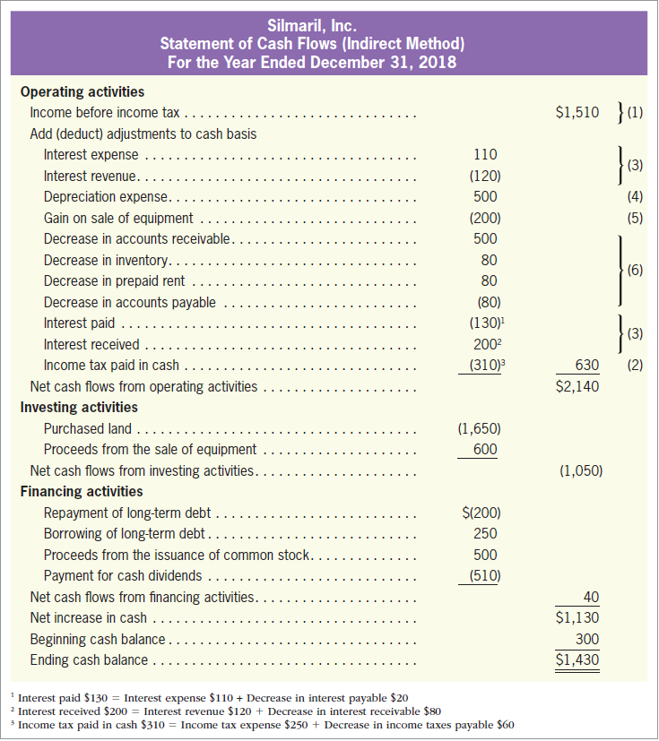
Converting from an Accrual Basis to a Cash Basis
LO4
Exhibit 13.8

Slide 29
Converting from an Accrual Basis to a Cash Basis
LO4
Exhibit 13.8

Slide 30
Converting from an Accrual Basis to a Cash Basis
LO4
(1) Start with the Item “Income before Income Tax”
IAS 7 requires operating cash flows for income tax payments to be presented separately.

Slide 31
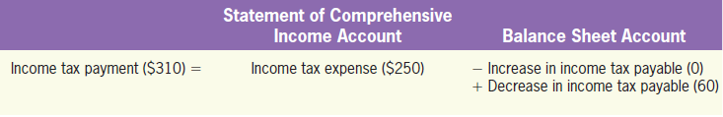
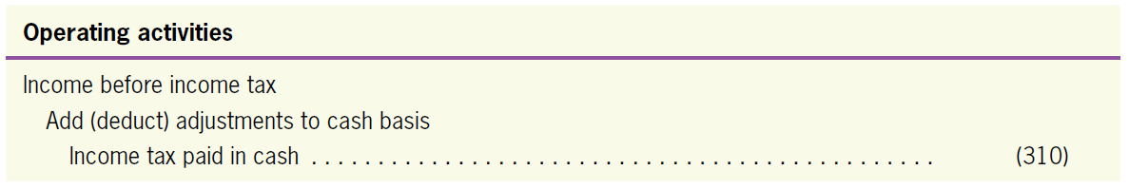
Converting from an Accrual Basis to a Cash Basis
LO4
(2) Calculate and Report Separately Operating Cash Flows for Income Tax Payments
Income Tax Payable
 |  | Beg. Bal. | 260
Payment for income tax | 310 | Income tax expense | 250
 |  | End. Bal. | 200

Slide 32
Converting from an Accrual Basis to a Cash Basis
LO4
(3-1) Add back interest expense and deduct interest revenue.
IAS 7 requires to separately list interest payments and interest receipts.

Slide 33
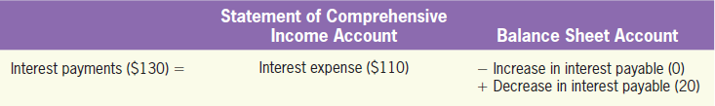
Converting from an Accrual Basis to a Cash Basis
LO4
(3-2) Calculate and report operating cash flows (separately) for the payments of interests, and the receipts of interests
Interest Payments
Interest Payable
 |  | Beg. Bal. | 120
Payment for interest | 130 | Income tax expense | 110
 |  | End. Bal. | 100

Slide 34
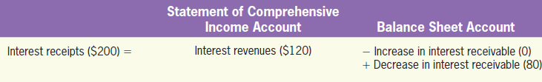
Converting from an Accrual Basis to a Cash Basis
LO4
(3-2) Calculate and report operating cash flows (separately) for the payments of interests, and the receipts of interests
Interest Receipts
Interest Receivable
Beg. Bal. | 250
Interest revenues | 120 | Receipts for interest | 200
End. Bal. | 170

Slide 35
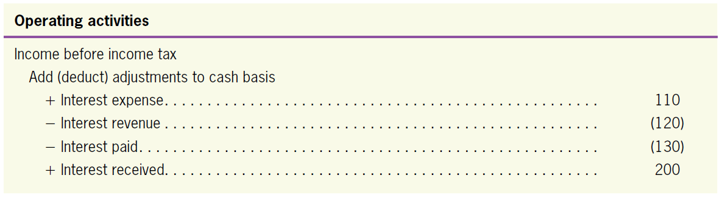
Converting from an Accrual Basis to a Cash Basis
LO4
(3-2) Calculate and report operating cash flows (separately) for the payments of interests, and the receipts of interests

Slide 36
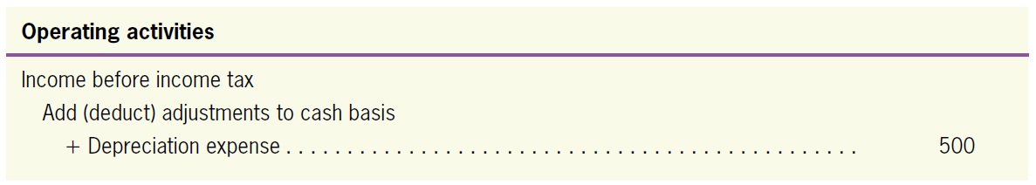
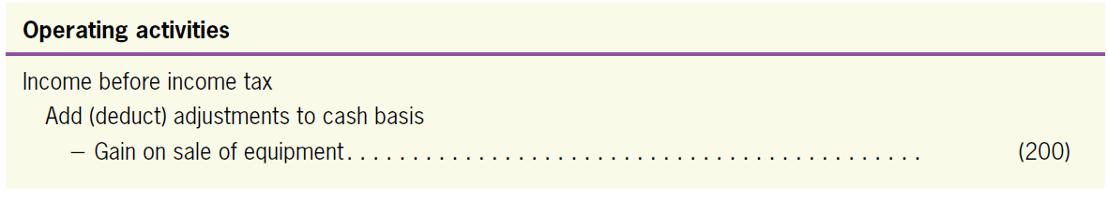
Converting from an Accrual Basis to a Cash Basis
LO4
(4) Add back operating expenses not involved with cash outflows
(5) Deduct all the gains and add back all the losses resulting from investing or financing activities

Slide 37
Converting from an Accrual Basis to a Cash Basis
LO4
(6) Adjust changes in non-cash current assets and current liability accounts
Decrease in Accounts Receivable
Decrease in Inventory
Account Receivable
Beg. Bal. | 2,500
Purchase | 10,000 | Receipts from customers | 10,500
End. Bal. | 2,000
Inventory
Beg. Bal. | 2,080
Purchase | 7,820 | Cost of goods sold | 7,900
End. Bal. | 2,000

Slide 38
Converting from an Accrual Basis to a Cash Basis
LO4
(6) Adjust changes in non-cash current assets and current liability accounts
Decrease in Prepaid Rent
Decrease in Accounts Payable
Prepaid Rent
Beg. Bal. | 100
Payments for rent | 30 | Rent expense | 110
End. Bal. | 20
Account Receivable
 |  | Beg. Bal. | 1,800
Payments for inventory | 7,900 | Purchases (See6(b) transaction) | 7,820
 |  | End. Bal. | 1,720

Slide 39
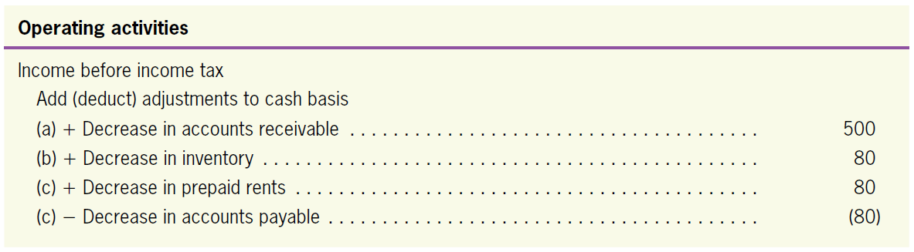
Converting from an Accrual Basis to a Cash Basis
LO4
(6) Adjust changes in non-cash current assets and current liability accounts
(d)

Slide 40
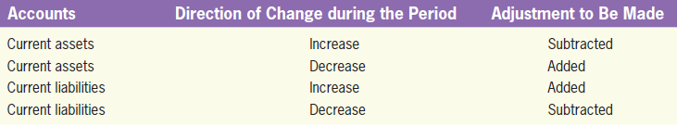
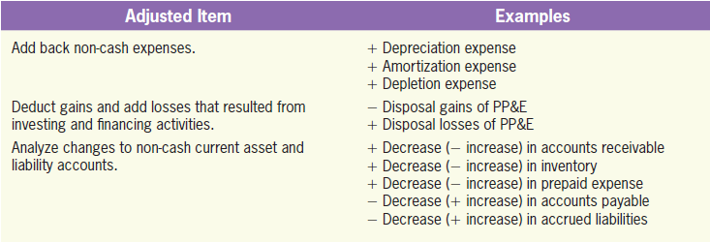
Some Rules of Thumb and Summary of Three Accrual Adjustments
LO4
Some Rules of Thumb
Summary of Three Accrual Adjustments

Slide 41
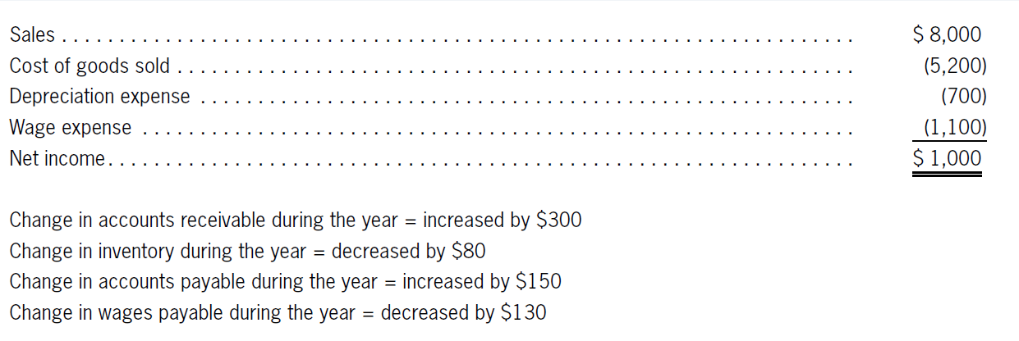
Quiz Yourself
LO4
Lathrop Company provides the following statement of comprehensive income and balance sheet information:

Slide 42
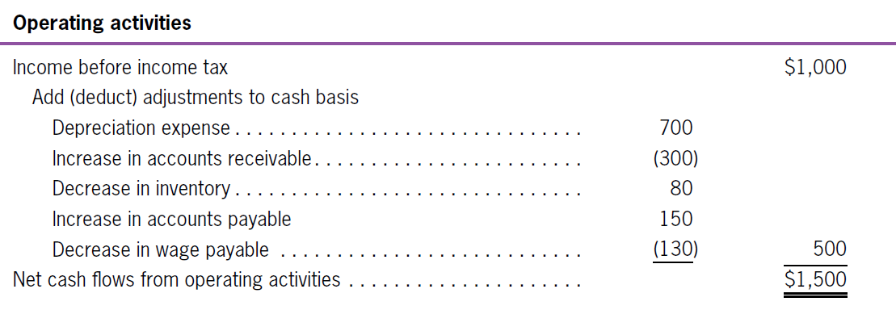
Quiz Yourself
LO4
Solution

Slide 43
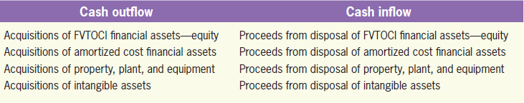
Investing Activities
Cash Flows from Investing Activities and Financing Activities
LO5
(a) Land
Land
Beg. Bal. | 300
Purchase land with cash Purchase land with notes | 1,650 50
End. Bal. | 2,000
Notes Payable
 |  | Beg. Bal. | 0
 |  | Purchase land | 50
 |  | End. Bal. | 50

Slide 44
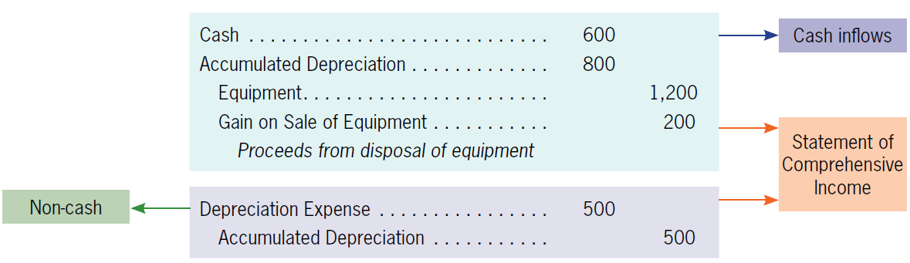
Investing Activities
LO5
(b) Equipment
Equipment
Beg. Bal. | 3.700
 |  | Sales | 1,200
End. Bal. | 2,500
Accumulated Depreciation-Equipment
 |  | Beg. Bal. | 1,200
Sale | 800 | Depreciation expense | 500
 |  | End. Bal. | 900

Slide 45
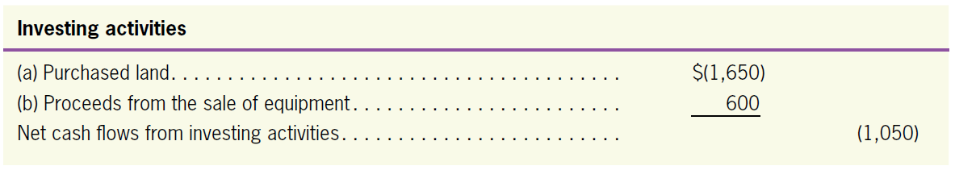
Investing Activities
LO5

Slide 46
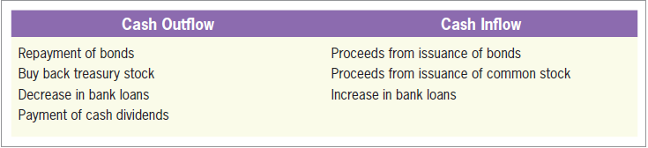
Financing Activities
LO5
(a) Long-term debt
Long-term Debt
 |  | Beg. Bal. | 500
Repay debts | 200 | Issue debts | 250
 |  | End. Bal. | 550

Slide 47
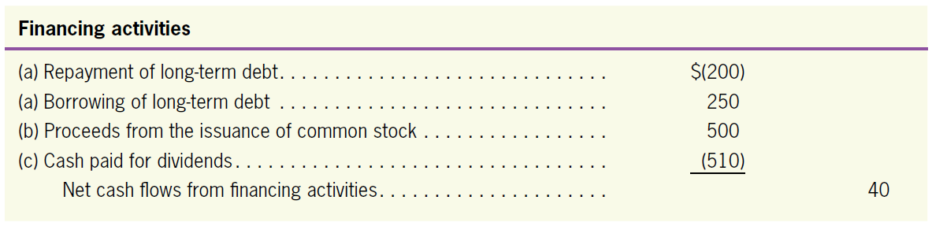
Financing Activities
LO5
(b) Common stock
(c) Retained earnings
Common Stock
 |  | Beg. Bal. | 3,000
 |  | Issue stocks | 500
 |  | End. Bal. | 3,500
Retained Earnings
 |  | Beg. Bal. | 2,350
Dividends | 510 | Net income | 1,260
 |  | End. Bal. | 3,100

Slide 48
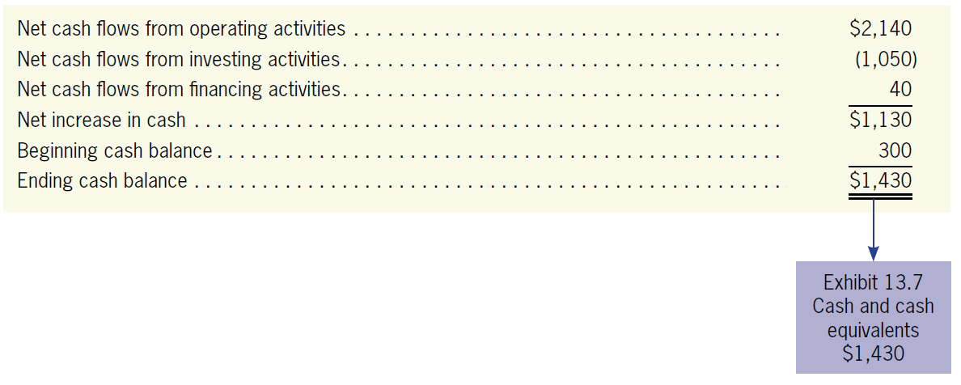
Summarize the Cash Flows and Check the Balance
LO5

Slide 49
Any Significant Investing or Financing Transactions That Does Not Involve Cash
LO5
Silmaril had a significant non-cash transaction—purchasing land by issuing $50 notes.
Such transactions shall be disclosed elsewhere in the financial statements in a way that provides all the relevant information about these investing and financing activities.

Slide 50
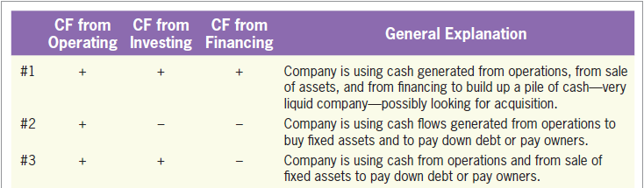
Information from the Statement of Cash Flows
Using Information from the Statement of Cash Flows to Make Decisions
LO6
Compare companies’ policies by analyzing cash flows from operating, investing, and financing activities.
Help investors, creditors, and others assess the amounts, timing, and uncertainty of future cash flows.
Analysis of Statement of Cash Flows: Patterns
Exhibit 13.10

Slide 51
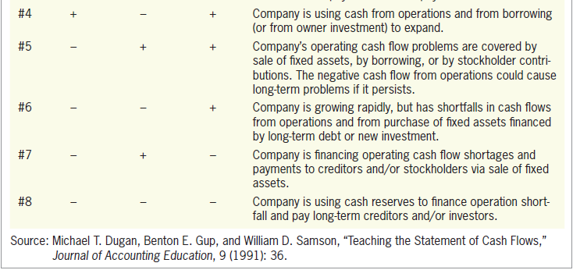
Information from the Statement of Cash Flows
LO6
Analysis of Statement of Cash Flows: Patterns
Exhibit 13.10

Slide 52
Information from the Statement of Cash Flows
LO6
Cash Flow Patterns of Selected Companies Traded on the TWSE (as of 2015)
As of 2015, about 70% of the companies traded on Taiwan Stock Exchange (TWSE) follow #2 (44%), #4 (15%), and #6 (10%).
Among the companies following #2, a great majority earned net income and had positive cash flows from operating activities (#2–1);
The remainder suffered net losses but still had positive cash flows from operating activities (#2–2).

Slide 53
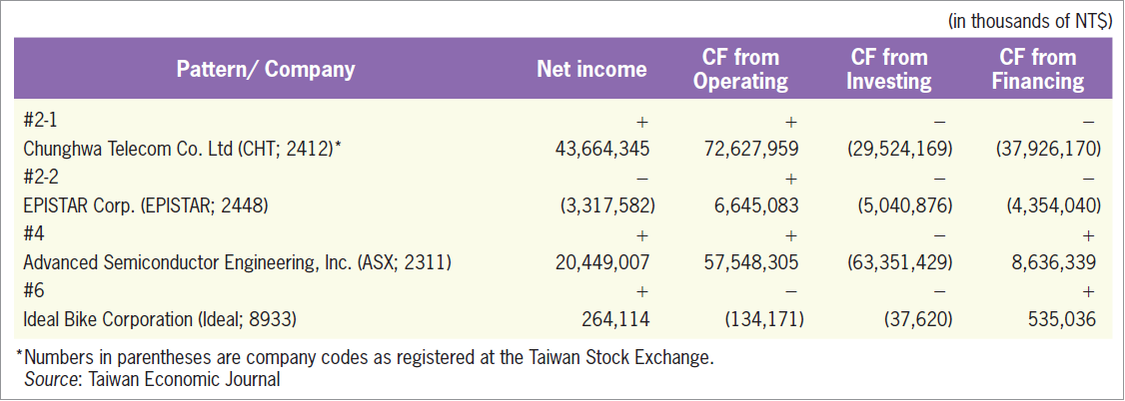
Information from the Statement of Cash Flows
LO6
Cash Flow Patterns of Selected Companies Traded on the TWSE (as of 2015)
Exhibit 13.11

Slide 54
The Basic Idea of Direct Method*
Cash Flows from Operating Activities: Direct Method
LO7
Adjust all the items in the statement of comprehensive income from accrual basis to cash basis.
Three steps:
Eliminate expenses not involving cash.
Eliminate the effects of non-operating activities.
Adjust the remaining figures from an accrual basis to a cash basis.

Slide 55
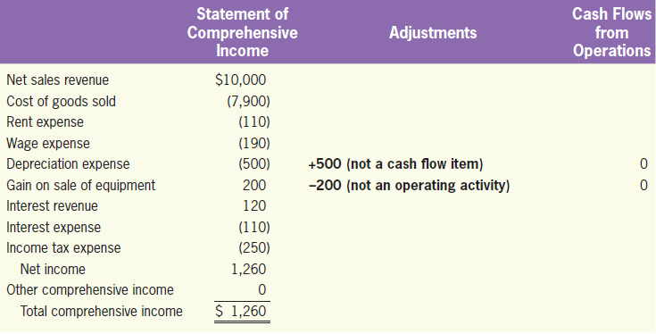
Cash Flows from Operating Activities: Direct Method*
LO7
Removing depreciation expense and eliminating the gain on the sale of the equipment.

Slide 56
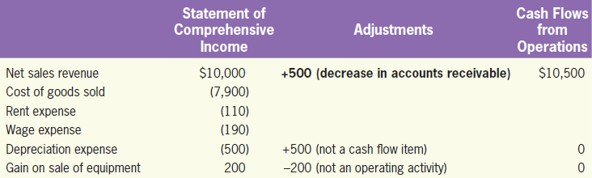
Cash Flows from Operating Activities: Direct Method*
LO7
(a) Cash received from customers
Account Receivable
Beg. Bal. | 2,500
Sales | 10,000 | Receipts from customers | 10,500
End. Bal. | 2,000

Slide 57
Cash Flows from Operating Activities: Direct Method*
LO7
(b) Cash payment to vendors
Inventory
Beg. Bal. | 2,080
Purchase | 7,820 | Cost of goods sold | 7,900
End. Bal. | 2,000
Accounts Payable
 |  | Beg. Bal. | 1,800
Payments for inventory | 7,900 | Purchase | 7,820
 |  | End. Bal. | 1,720

Slide 58
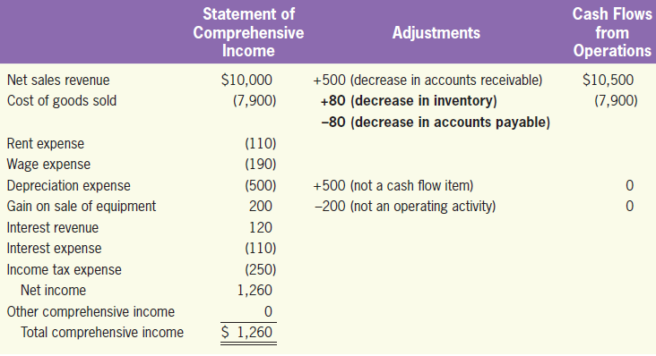
Cash Flows from Operating Activities: Direct Method*
LO7
(b) Cash payment to vendors

Slide 59
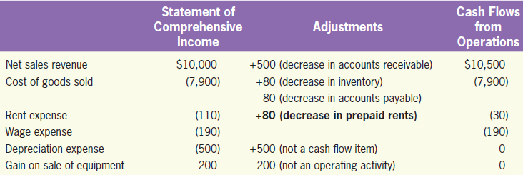
Cash Flows from Operating Activities: Direct Method*
LO7
(c) Cash paid for operating expense: rent expense and wage expense
Prepaid Rent
Beg. Bal. | 100
Payments for rent | 30 | Rent expense | 110
End. Bal. | 20

Slide 60
Cash Flows from Operating Activities: Direct Method*
LO7
(d) Cash paid for interest and income tax
Interest Receivable
Beg. Bal. | 250
Interest revenues | 120 | Receipts for interest | 200
End. Bal. | 170
Interest Payable
 |  | Beg. Bal. | 120
Payments for interest | 130 | Interest expense | 110
 |  | End. Bal. | 100
Income Tax Payable
 |  | Beg. Bal. | 260
Payments for income tax | 310 | Tax expense | 250
 |  | End. Bal. | 200

Slide 61
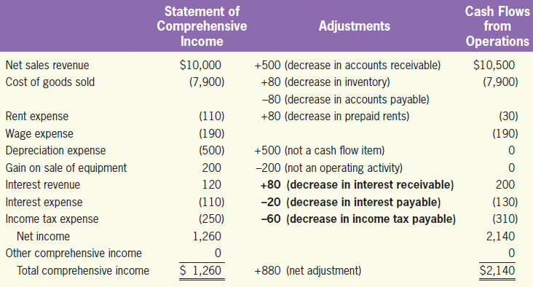
Cash Flows from Operating Activities: Direct Method*
LO7
(d) Cash paid for interest and income tax

Slide 62
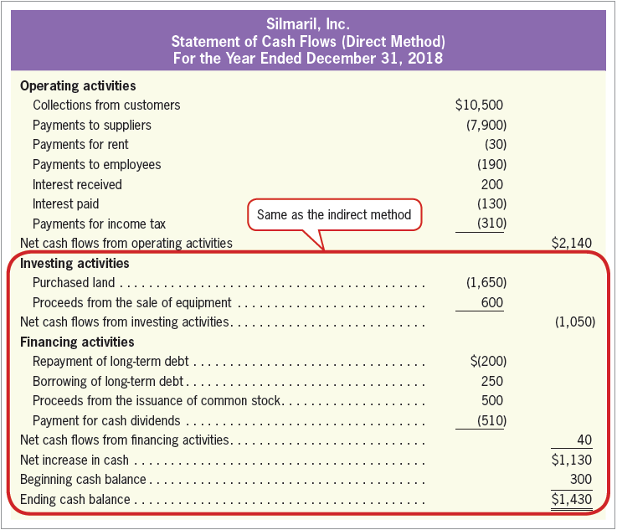
Cash Flows from Operating Activities: Direct Method*
LO7
Statement of Cash Flows—Direct Method
There is no difference in the presentation of investing and financing activities.
Exhibit 13.12

Slide 63
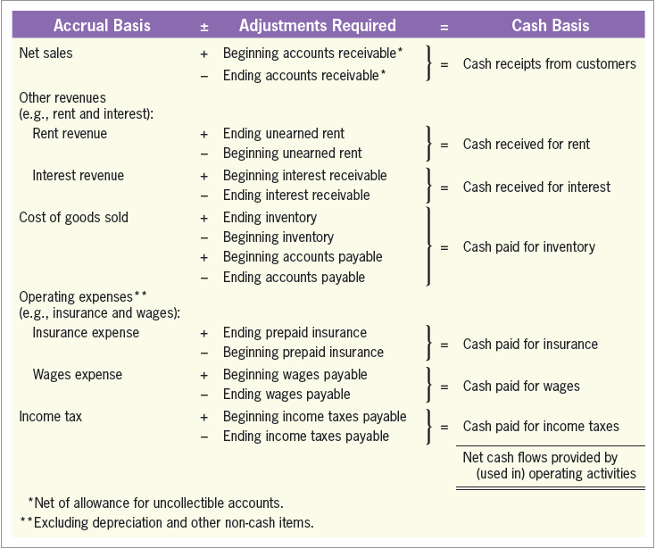
Cash Flows from Operating Activities: Direct Method*
LO7
Guidelines for Converting from Accrual to Cash Basis
Exhibit 13.13

